Slide 1
Superconducting Quantum Processor
By,
Antony S Chirayil

Slide 2
Introduction
Despite the incredible power of today’s supercomputers, many complex computing problems cannot be addressed by conventional systems. The huge growth of data and our need to better understand everything from the universe to our own DNA leads us to seek new tools that can help provide answers.
Quantum computing is the next frontier in computing, providing an entirely new approach to solving the world’s most difficult challenges. Since 1982, Richard Feynman proposed the idea of quantum computing for the first time, it has become a new field of interest for many physics and computer scientists.
Although it’s more than 30 years that this concept has been presented but it’s still considered as unknown and several subjects are open for research.
There are several models of quantum computing, including the quantum circuit model, quantum Turing machine, adiabatic quantum computer, one-way quantum computer, and various quantum cellular automata. The most widely used model is the quantum circuit

Slide 3
History
1982 - Feynman proposed the idea of creating machines based on the laws of quantum mechanics instead of the laws of classical physics.
1985 - David Deutsch developed the quantum Turing machine, showing that quantum circuits are universal.
1994 - Peter Shor came up with a quantum algorithm to factor very large numbers in polynomial time.
1997 - Lov Grover develops a quantum search algorithm with O(√N) complexity

Slide 4
What is a Quantum Computer and Qubit?
classical computers encode information in bits and each bit can represent a 0 or a 1 these zeros and ones act as on-off switches that ultimately translate into compute functions to perform a simple calculation.
make use of two key principles of quantum physics superposition and entanglement superposition means that each qubit can represent a zero a one or both at the same time and entanglement happens when two qubits in a superposition are correlated with one another meaning the state of one whether it's a 0 a 1 or both depends on the state of another using these

Slide 5
Continuation……
let's look at some numbers, take a classical n bit computer with n representing the number of bits it can represent and examine only one system state at a time an N cubed computer however would have the power to represent 2 to the power of n system states and perform parallel operations on all those states at once this means that every time you add just one more qubit to a quantum computer the number of states that can represent and examine the so a 50 cubit quantum machine could examine two to the power of 50 states at once this exponential increase in power together with the entanglement of qubits is what allows quantum computers to solve certain problems so much more efficiently while a classical computer solves a problem like the maze by testing each possible route one at a time a quantum computer uses its entangled quantum state to find the correct route quicker with far fewer calculations think of it this way technologies that currently run on classical computers can expertly find patterns and insights buried in vast amounts of existing data but quantum computers will deliver solutions where patterns cannot be seen because sufficient data does not exist or the possibilities for discovering an optimal answer are too enormous to ever be processed by a classical computer

Slide 6
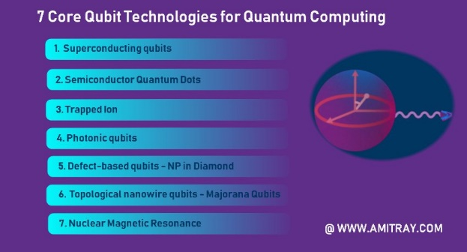
Technologies for implementing Quantum Computing

Slide 7
Superconducting Qubits
Superconducting qubits are solid state electrical circuits.Compared with the qubits based on other quantum systems(such as trapped ions, nuclear magnetic resonance, linear optical systems, etc.), superconducting qubits have the following advantages:
High designability. Superconducting qubit system has high designability. Different types of qubits, such as charge qubits, flux qubits, and phase qubits, can be designed.
Scalability. The preparation of superconducting qubits isbased on the existing semiconductor microfabrication process.High-quality devices can be prepared by leveraging advanced chip-making technologies, which is good for manufacturing and scalability.
Easy to couple. The circuit nature of the superconducting qubit system makes it relatively easy to couple multiple qubits together. In general, superconducting qubits can be coupledby capacitance or inductance.
Easy to couple. The circuit nature of the superconducting qubit system makes it relatively easy to couple multiple qubits together. In general, superconducting qubits can be coupled by capacitance or inductance.
Easy to control. The operation and measurement of superconducting qubits compatible with microwave control and operability. Thus, commercial microwave devices and equipment can be used in superconducting quantum computing experiments.

Slide 8
Superconducting qubit archetypes
Superconducting qubits generally consist of superconducting electrodes,
or islands, that are interconnected by Josephson junctions.
According to different degrees of freedom, superconducting qubits are mainly divided into three categories: charge qubits [25, 29], flux qubits [30], and phase qubits [31]. We can distinguish these tree types of superconducting qubit according to the ratio EJ=EC, where EJ is Josephson energy and EC is charging energy.
T he charge qubit is is also called Cooper-pair box qubit, which is shown in Fig. 1(a). For the charge qubit, the electrostatic energy of the Cooper-pair on the superconducting island is much larger than the Josephson coupling energy onthe junction EJ EC. The relevant quantum variable isthe number of Cooper pairs that cross Josephson junction.
Fig. 1(b) is a schematic diagram of a flux qubit. Typically,EJ=EC is much lager than 1 but smaller than 100 for flux qubit. The states of the flux qubit are distinguished by the direction of the continuous current state in the superconducting loop. As shown in Fig. 1(c), the phase qubit is a current-biased single-junction device with a large ratio EJ=EC (EJ EC).
Using the two lowest energy levels of the washboard potential, one phase qubit can be encoded.
FIG. 1. Superconducting qubit circuit diagram. (a) Charge qubit composed of a Josephson junction and a capacitor. Adjusting the voltage Vg can control the number of Cooper pairs. (b) Flux qubit. L is the loop inductance. Changing the bias flux can adjust the energy level structure of the qubit. (c) Phase qubit. Adjusting the bias current Ib can tilt the potential energy surface.

Slide 9
New types of superconducting qubits
Based on the three superconducting qubit archetypes, many
new types of superconducting qubits are derived, such as
Transmon-type qubit
C-shunt flux qubit
Fluxonium
0-π qubit
hybrid qubit

Slide 10
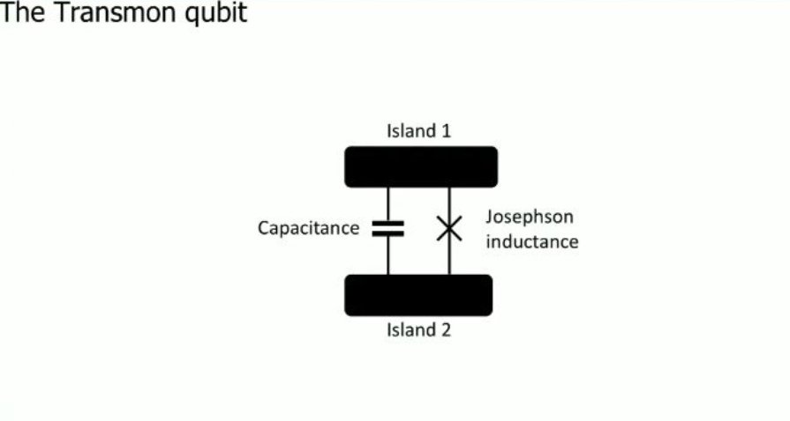
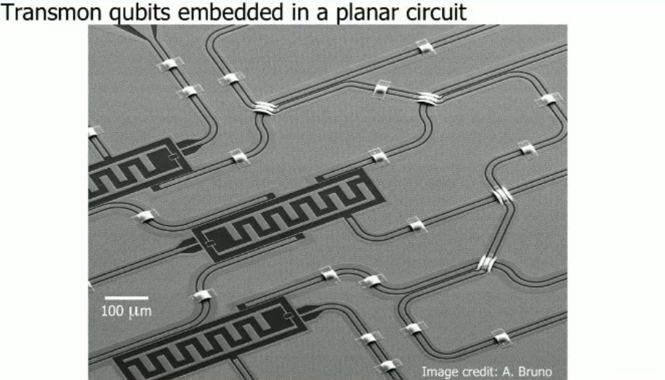
Transmon qubit
The transmon is the superconducting qubit.Transmon-type qubit, including Transmon, Xmon, Gmon,3D Transmon etc., is currently the most popular superconducting qubit due to its simplicity and the flexibility of cQED Architecture
In its simplest form, the transmon consists of two islands interconnected by one junction. the transmon, the inductance is provided by a Josephson junction and not by a typical coil inductor.
As a final note, we build our transmon not from one but two Josephson junctions in parallel.
This gives us the possibility to tune the inductive element and thereby the qubit transition frequency,
by threading a magnetic flux through the loop defined by the two junctions.
We can do this independently for each qubit and on nanosecond timescales.
This capability is the workhorse enabling two-qubit gates.

Slide 11
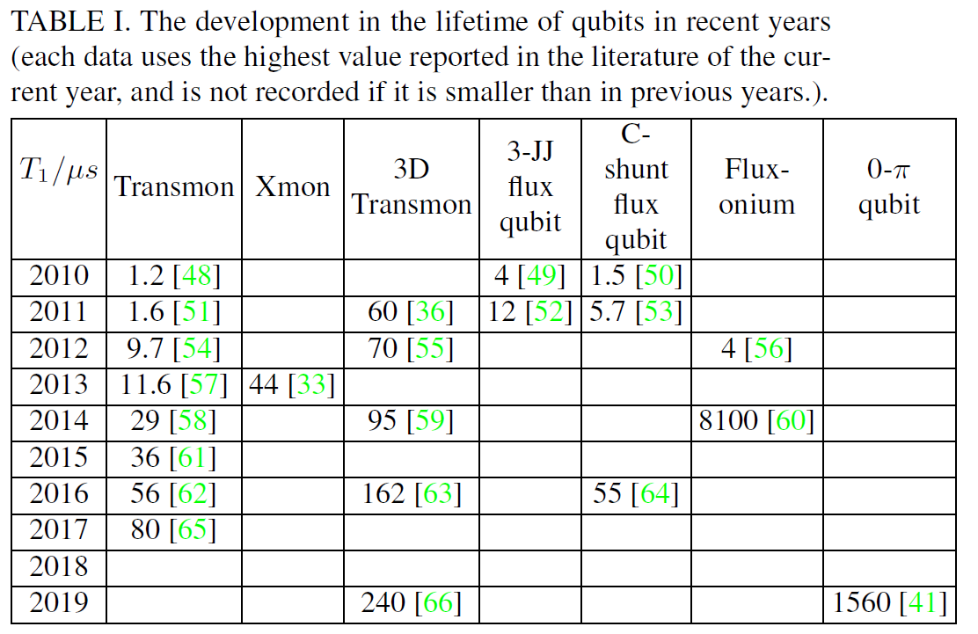
Qubit’s lifetime
By improving the structure and parameters of the superconducting qubits, as well as the preparation techniques and materials, the lifetime of the superconducting qubits has been greatly enhanced.
TABLE I summarizes the development in the lifetime of qubits over the past decade.

Slide 12
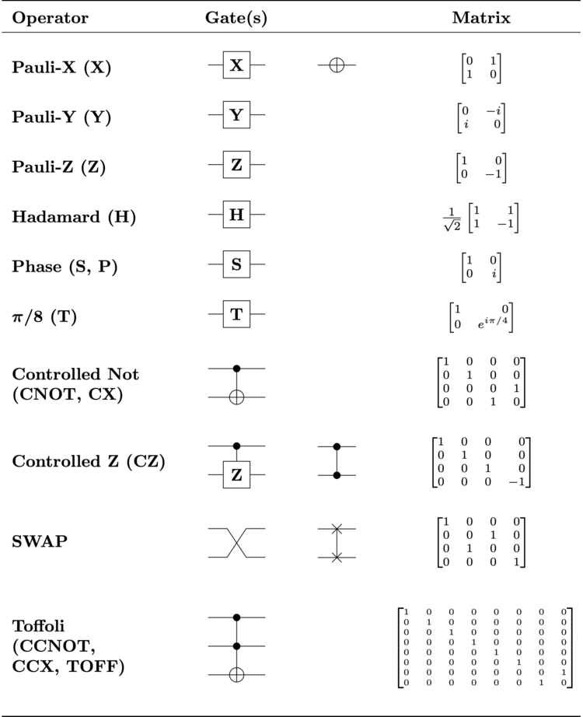
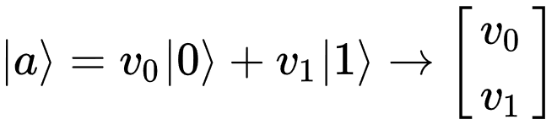
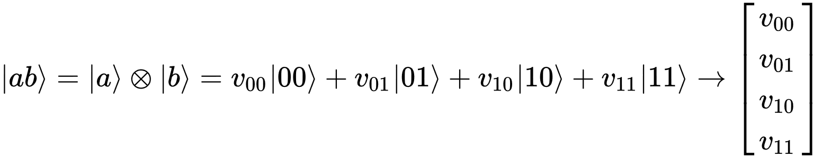
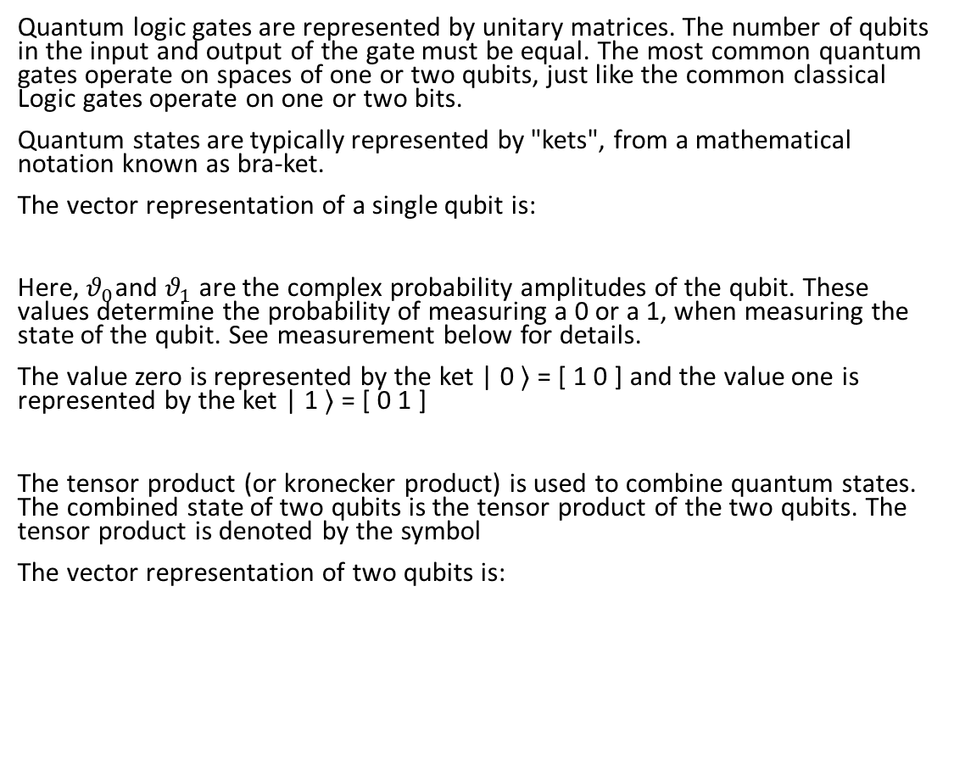
QUBIT CONTROL using Quantum logic gate
Quantum logic gates are represented by unitary matrices. The number of qubits in the input and output of the gate must be equal. The most common quantum gates operate on spaces of one or two qubits, just like the common classical Logic gates operate on one or two bits.
Quantum states are typically represented by "kets", from a mathematical notation known as bra-ket.
The vector representation of a single qubit is:
Here, $θ_{0}$and $θ_{1}$are the complex probability amplitudes of the qubit. These values determine the probability of measuring a 0 or a 1, when measuring the state of the qubit. See measurement below for details.
The value zero is represented by the ket | 0 ⟩ = [ 1 0 ] and the value one is represented by the ket | 1 ⟩ = [ 0 1 ]
The tensor product (or kronecker product) is used to combine quantum states. The combined state of two qubits is the tensor product of the two qubits. The tensor product is denoted by the symbol
The vector representation of two qubits is:

Slide 13
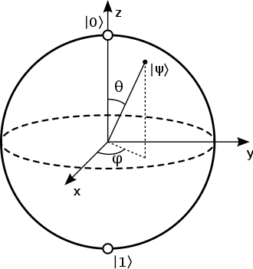
Gates For Single qubit, Two qubits and Three Qubits
Single Qubit control:
In accordance with Bloch sphere:
Hadamard (H) gate
Pauli-X , Y, Z gate
Phase shift gates
Other gates are:
Square root of NOT gate (√NOT)
Two Qubit Control:
Swap (SWAP) gate
Square root of Swap gate (√SWAP)
Controlled (cX cY cZ) gates (CNOT)
Frequency tuning gates
Cross-resonance gate
Parametric gates
Three Qubit Control:
Toffoli (CCNOT) gate
Fredkin (CSWAP) gate
Deutsch gate
The Bloch sphere is a unit 2-sphere.The north and south poles of the Bloch sphere are typically chosen to correspond to the standard basis vectors |0⟩ and |1⟩ respectively, which in turn might correspond e.g. to the spin-up and spin-down states of an electron. This choice is arbitrary, however. The points on the surface of the sphere correspond to the pure states of the system, whereas the interior points correspond to the mixed states.
Multiple Qubit Control:
Multi-qubit gates

Slide 14
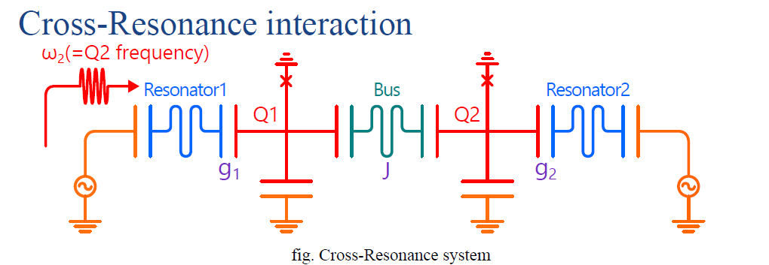
Cross-Resonance Gate
The cross-resonance gate is an entangling gate for fixed frequency superconducting qubits, which is implemented by applying a microwave drive to a system of two coupled qubits
The cross-resonance gate was first implemented in 2011
CNOT gate,so-called two-qubit entangling gate,is used here
Typical pulse duration : 200-500ns
Typical gate fidilities: 96-99%

Slide 15
Superconducting Quantum Circuit Basics
Here we focus superconducting quantum processors with Josephson junction-based transmon qubits and all-microwave cross-resonance two-qubit gates.
Physical Qubit and Frequency
Qubit Layout
Qubit Connection
Qubit Mapping
Fabrication Variation
Frequency Collision

Slide 16
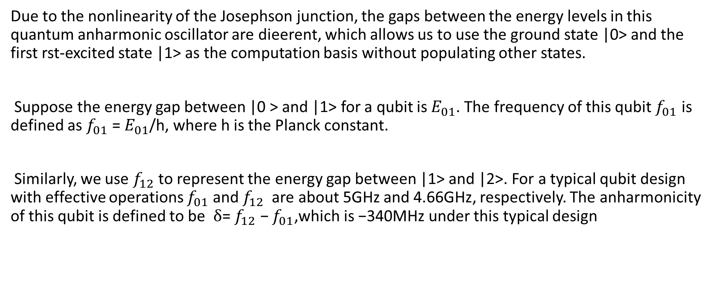
Physical Qubit and Frequency
Due to the nonlinearity of the Josephson junction, the gaps between the energy levels in this quantum anharmonic oscillator are dierent, which allows us to use the ground state |0> and the first rst-excited state |1> as the computation basis without populating other states.
Suppose the energy gap between |0 > and |1> for a qubit is${ E}_{01}$. The frequency of this qubit $f_{01}$ is defined as $f_{01}$ = $E_{01}$/h, where h is the Planck constant.
Similarly, we use $f_{12}$to represent the energy gap between |1> and |2>. For a typical qubit design with effective operations $f_{01}$and $f_{12}$are about 5GHz and 4.66GHz, respectively. The anharmonicity of this qubit is defined to be δ= $f_{12}$ − $f_{01}$,which is −340MHz under this typical design

Slide 17
Qubit Layout
The superconducting physical qubits are connected on a 2-dimensional planar substrate. Although the qubit placement can be flexible, major vendors fabricate the qubits in a regularized structure to ensure scalability and reduce the fabrication complexity.
For example:
IBM’s 16-qubit and 20-qubit chips placed their qubits on the nodes of 2x8 and 4x5 lattices, respectively.
Google’s 72-qubit chip placed its qubits on some nodes of an 11x12 lattice

Slide 18
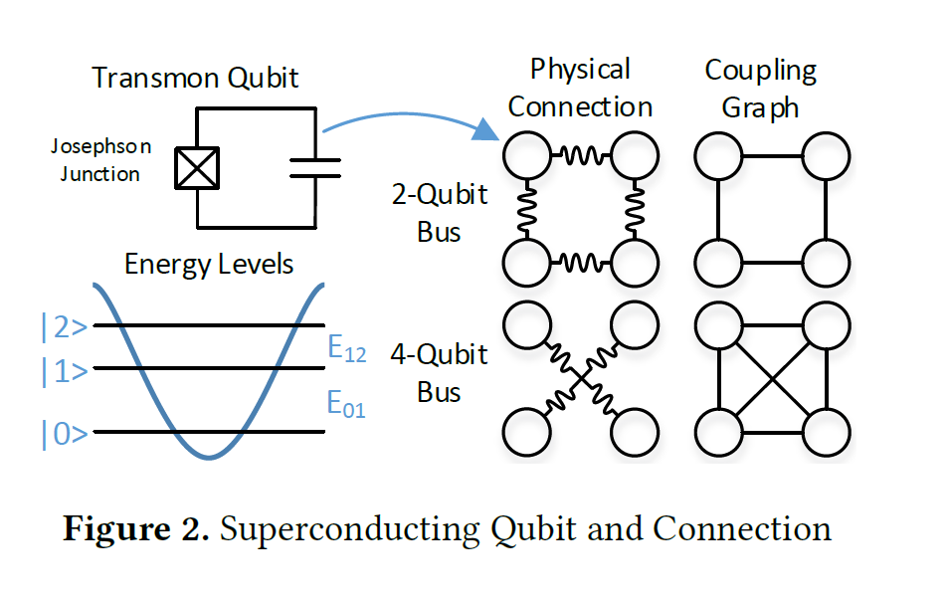
Qubit Connection
To enable two-qubit gates between two physical qubits, resonators, also known as qubit buses, are employed to connect nearby qubits .
For example,
Figure shows two types of commonly used buses. The first one is a 2-qubit bus connecting two physical qubits.
The second one is a 4-qubit bus, which connects four physical qubits in a square together.
The coupling graphs of these two types of buses are shown on the right. Compared with a 2-qubit bus, 4-qubit bus support two-qubit gates on not only the four qubit pairs on the edges but also two qubit pairs on the diagonals.

Slide 19
Qubit Mapping
It is usually assumed that a two-qubit gate can be applied on arbitrary two logical qubits in a quantum program but some two-qubit gates may not be executable due to the limited qubit connection on a superconducting quantum processor.
On the hardware side, this problem can be relieved by employing more physical qubit connections so that two-qubit gates can be directly supported on more qubit pairs.
On the software side, a qubit-remapping compiler can resolve the dependency of the remaining unexecutable two-qubit gates while additional operations must be introduced with longer execution time and higher error rate.
Therefore, more physical qubit connections can help with the overall performance by allowing native two-qubit gates on more physical qubit pairs.

Slide 20
QUBIT READOUT
Fast and high fidelity qubit readout is crucial in quantum computing. There are several different readout techniques for superconducting qubit, such as charge measurement,flux measurement inductance measurement, etc.
The dispersive readout is the currently most common readout technique in the circuit QED architecture, which we will briefly introduce in this section.
In addition, we will also introduce the techniques to improve the fidelity and speed of qubit readout.
Other Techniques of Qubit Readouts are:
High-fidelity single-shot readout:
To achieve fast, high-fidelity single shot readout, Purcell filter and parametric amplifier are typically tools for superconducting quantum computing
1.Purcell Filter
2. Josephson parametric amplifier (JPA)
3. Impedance-transformed parametric amplifier (IMPA)
4. Traveling wave parametric amplifier (TWPA)

Slide 21
Dispersive readout
Dispersive readout is to obtain the qubit state information through the readout resonator.
The qubit circuit is coupled to the readout resonator through capacitance or inductance, and the state of the qubit is detected by measuring the transmission coefficient of the readout resonator.
During the measurement, the qubit and the readout resonator form the Hamiltonian of the Jaynes-Cummings model
The dispersive readout provides a feasible way for the quantum non-demolition (QND) readout of superconducting quantum computing.

